Slide 1
Tools in performance troubleshooting

Slide 4
Tools in performance troubleshooting

Slide 5
Lesson 3: Tools in performance troubleshooting
Fiddler
Browser Developer Tools
IE/Microsoft Edge/Chrome
Page Diagnostic Tool
Network settings

Slide 6
What is Fiddler?
Local proxy software:
Can do more (ex: request replay).
Separate installation:
Might be a challenge in certain environments.
Each request is a separate entry:
TCP connect and SSL handshake in one.
Actual request in another one.

Slide 7
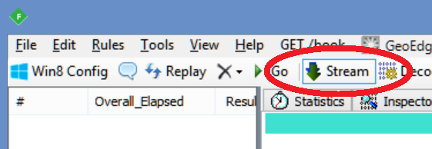
What is Fiddler? (cont.)
Can import/export network trace:
Also export from Browser Developer Tools.
Easier to read, not as sophisticated.
SSL sniffing possible:
Important for some troubleshooting scenarios.
Tools/Options/HTTPS/Decrypt HTTPS traffic.
Must be set to streaming mode:
Otherwise the browser values are invalid

Slide 8
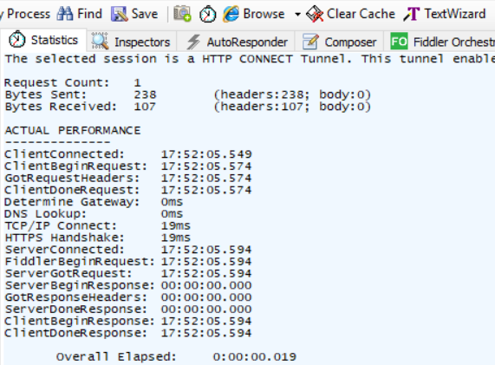
Fiddler explained - Request statistics
TCP connect (19ms).
SSL handshake (19ms).

Slide 9
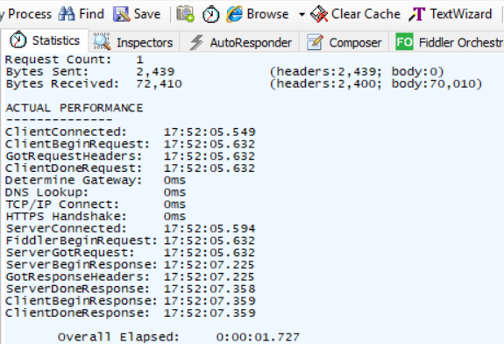
Fiddler explained - Request statistics (cont.)
Additional statistical information:
No summary like in the browser.
Send time:
ServerGotRequest - FiddlerBeginRequest
TTFB:
ServerBeginResponse - ClientConnected
Download time:
ServerDoneResponse - ServerBeginResponse
Notes:
Timers
ClientConnected - Exact time taken by the client browser to establish a TCP/IP connection with Fiddler.
ClientBeginRequest - The time at which this HTTP request began. It might be that the request began later than the ClientConnected time because of client connection reuse.
ClientDoneRequest - Exact time in which the client browser completed sending the HTTP request to Fiddler.
DNSTime - Number of milliseconds that the Fiddler spent in DNS searching for the server's IP address.
GatewayDeterminationTime - Number of milliseconds that the Fiddler spent in determining the upstream gateway proxy to use (For example, processing autoproxy script). It is mutually exclusive to DNSTime.
TCPConnectTime - Number of milliseconds that the Fiddler spent in establishing a connection between TCP/IP and the server’s IP address.
HTTPSHandshakeTime - Amount of time spent in HTTPS handshake.
ServerConnected - Time at which this connection was established with the server. It might be much earlier than ClientConnected because of server connection reuse.
FiddlerBeginRequest - The time at which Fiddler began sending the HTTP request to the server.
ServerGotRequest - Exact time required by the Fiddler to complete sending or resending the HTTP request to the server.
ServerBeginResponse - Exact time at which the Fiddler received the first bytes of the server's HTTP response.
ServerDoneResponse - Exact time at which the Fiddler received the last bytes of the server's HTTP response.
ClientBeginResponse - Exact time at which the Fiddler began transmitting the HTTP response to the client browser.
ClientDoneResponse - Exact time at which the Fiddler completed transmitting the HTTP response to the client browser.

Slide 10
Fiddler explained - Examples of Bottlenecks
Server Think Time :
Subtract ServerGotRequest from ServerBeginResponse.
Shows time spent by server to generate response.
SPRequestDuration (g_duration) in page source.
Large values mean long server process time.
This will assist with narrowing down if it is either something with the content of the page or with the service.
Notes:
Server Think Time is calculated by Subtracting ServerGotRequest from ServerBeginResponse. If there's a large amount of time elapsed in this interval, the server is the bottleneck.
Timers
ClientConnected - Exact time taken by the client browser to establish a TCP/IP connection with Fiddler.
ClientBeginRequest - The time at which this HTTP request began. It might be that the request began later than the ClientConnected time because of client connection reuse.
ClientDoneRequest - Exact time in which the client browser completed sending the HTTP request to Fiddler.
DNSTime - Number of milliseconds that the Fiddler spent in DNS searching for the server's IP address.
GatewayDeterminationTime - Number of milliseconds that the Fiddler spent in determining the upstream gateway proxy to use (For example, processing autoproxy script). It is mutually exclusive to DNSTime.
TCPConnectTime - Number of milliseconds that the Fiddler spent in establishing a connection between TCP/IP and the server’s IP address.
HTTPSHandshakeTime - Amount of time spent in HTTPS handshake.
ServerConnected - Time at which this connection was established with the server. It might be much earlier than ClientConnected because of server connection reuse.
FiddlerBeginRequest - The time at which Fiddler began sending the HTTP request to the server.
ServerGotRequest - Exact time required by the Fiddler to complete sending or resending the HTTP request to the server.
ServerBeginResponse - Exact time at which the Fiddler received the first bytes of the server's HTTP response.
ServerDoneResponse - Exact time at which the Fiddler received the last bytes of the server's HTTP response.
ClientBeginResponse - Exact time at which the Fiddler began transmitting the HTTP response to the client browser.
ClientDoneResponse - Exact time at which the Fiddler completed transmitting the HTTP response to the client browser.

Slide 11
Fiddler explained - Examples of Bottlenecks (cont.)
Upload Duration:
Subtracting ClientBeginRequest from ServerGotRequest.
Shows time spent sending the request to the server.
Large values indicate a long time spent sending data from the client to the server over the network.
More troubleshooting needs to be done on the network.
Notes:
Upload Duration is calculated by subtracting ClientBeginRequest from ServerGotRequest. When the delta is shown like this example, the time was spent sending data from the client to the server over the network.
More troubleshooting needs to be done on the network
Timers
ClientConnected - Exact time taken by the client browser to establish a TCP/IP connection with Fiddler.
ClientBeginRequest - The time at which this HTTP request began. It might be that the request began later than the ClientConnected time because of client connection reuse.
ClientDoneRequest - Exact time in which the client browser completed sending the HTTP request to Fiddler.
DNSTime - Number of milliseconds that the Fiddler spent in DNS searching for the server's IP address.
GatewayDeterminationTime - Number of milliseconds that the Fiddler spent in determining the upstream gateway proxy to use (For example, processing autoproxy script). It is mutually exclusive to DNSTime.
TCPConnectTime - Number of milliseconds that the Fiddler spent in establishing a connection between TCP/IP and the server’s IP address.
HTTPSHandshakeTime - Amount of time spent in HTTPS handshake.
ServerConnected - Time at which this connection was established with the server. It might be much earlier than ClientConnected because of server connection reuse.
FiddlerBeginRequest - The time at which Fiddler began sending the HTTP request to the server.
ServerGotRequest - Exact time required by the Fiddler to complete sending or resending the HTTP request to the server.
ServerBeginResponse - Exact time at which the Fiddler received the first bytes of the server's HTTP response.
ServerDoneResponse - Exact time at which the Fiddler received the last bytes of the server's HTTP response.
ClientBeginResponse - Exact time at which the Fiddler began transmitting the HTTP response to the client browser.
ClientDoneResponse - Exact time at which the Fiddler completed transmitting the HTTP response to the client browser.

Slide 12
Fiddler explained - Examples of Bottlenecks (cont.)
Download Duration:
Calculated by subtracting ServerBeginResponse from ServerDoneResponse.
Shows downloading the response from the server.
Large values indicate a long time spent downloading data from the server to the client over the network.
Notes:
Download Duration is calculated by subtracting ServerBeginResponse from ServerDoneResponse. This is the amount of time spent on the network transmitting the response data from the server to the client.
Timers
ClientConnected - Exact time taken by the client browser to establish a TCP/IP connection with Fiddler.
ClientBeginRequest - The time at which this HTTP request began. It might be that the request began later than the ClientConnected time because of client connection reuse.
ClientDoneRequest - Exact time in which the client browser completed sending the HTTP request to Fiddler.
DNSTime - Number of milliseconds that the Fiddler spent in DNS searching for the server's IP address.
GatewayDeterminationTime - Number of milliseconds that the Fiddler spent in determining the upstream gateway proxy to use (For example, processing autoproxy script). It is mutually exclusive to DNSTime.
TCPConnectTime - Number of milliseconds that the Fiddler spent in establishing a connection between TCP/IP and the server’s IP address.
HTTPSHandshakeTime - Amount of time spent in HTTPS handshake.
ServerConnected - Time at which this connection was established with the server. It might be much earlier than ClientConnected because of server connection reuse.
FiddlerBeginRequest - The time at which Fiddler began sending the HTTP request to the server.
ServerGotRequest - Exact time required by the Fiddler to complete sending or resending the HTTP request to the server.
ServerBeginResponse - Exact time at which the Fiddler received the first bytes of the server's HTTP response.
ServerDoneResponse - Exact time at which the Fiddler received the last bytes of the server's HTTP response.
ClientBeginResponse - Exact time at which the Fiddler began transmitting the HTTP response to the client browser.
ClientDoneResponse - Exact time at which the Fiddler completed transmitting the HTTP response to the client browser.

Slide 13
Title
The two traces below show classic network waits. There are similar related client waits that are often caused by network inspection and filtering software installed on the client.
Notes:
Timers
ClientConnected - Exact time taken by the client browser to establish a TCP/IP connection with Fiddler.
ClientBeginRequest - The time at which this HTTP request began. It might be that the request began later than the ClientConnected time because of client connection reuse.
ClientDoneRequest - Exact time in which the client browser completed sending the HTTP request to Fiddler.
DNSTime - Number of milliseconds that the Fiddler spent in DNS searching for the server's IP address.
GatewayDeterminationTime - Number of milliseconds that the Fiddler spent in determining the upstream gateway proxy to use (For example, processing autoproxy script). It is mutually exclusive to DNSTime.
TCPConnectTime - Number of milliseconds that the Fiddler spent in establishing a connection between TCP/IP and the server’s IP address.
HTTPSHandshakeTime - Amount of time spent in HTTPS handshake.
ServerConnected - Time at which this connection was established with the server. It might be much earlier than ClientConnected because of server connection reuse.
FiddlerBeginRequest - The time at which Fiddler began sending the HTTP request to the server.
ServerGotRequest - Exact time required by the Fiddler to complete sending or resending the HTTP request to the server.
ServerBeginResponse - Exact time at which the Fiddler received the first bytes of the server's HTTP response.
ServerDoneResponse - Exact time at which the Fiddler received the last bytes of the server's HTTP response.
ClientBeginResponse - Exact time at which the Fiddler began transmitting the HTTP response to the client browser.
ClientDoneResponse - Exact time at which the Fiddler completed transmitting the HTTP response to the client browser.

Slide 14
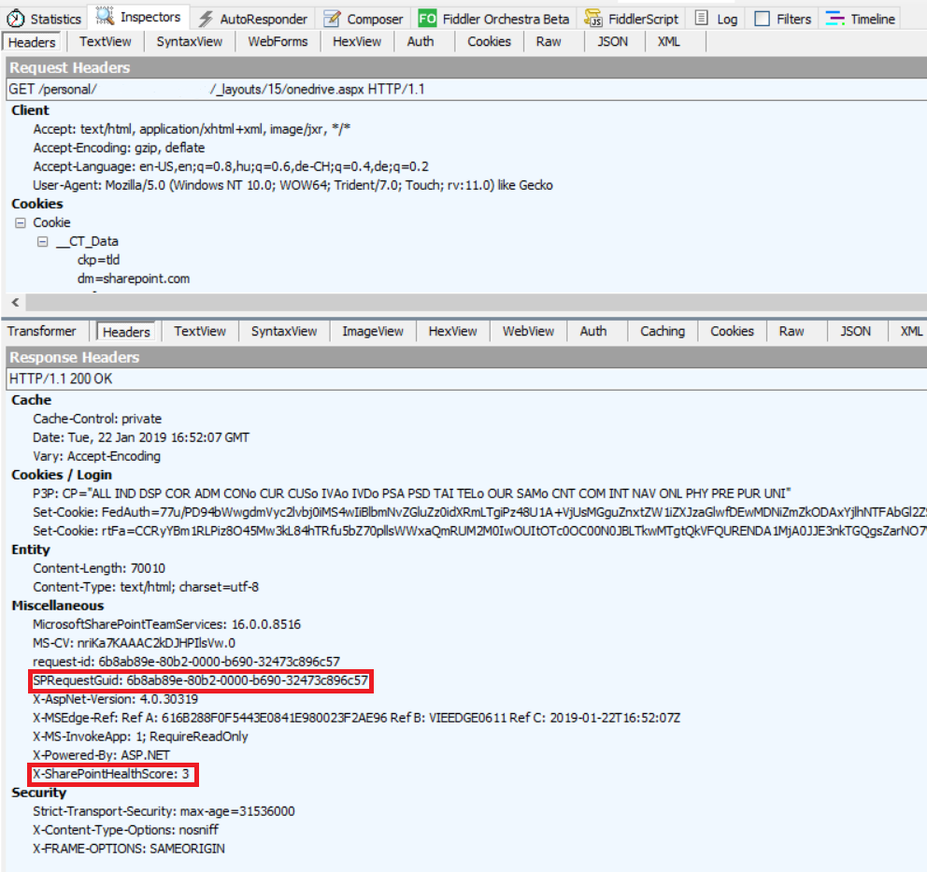
Fiddler explained - Headers
Inspectors tab
Upper part: request
Lower part: response
SPIisLatency (classic)
SPRequestDuration (classic)
SPRequestGuid
X-SharepointHealthScore (Not relevant in SPO!)

Slide 15
Fiddler explained – Other useful features
Filtering requests
Finding requests
JSON/XML view
Reissue/construct queries (Composer).
Request waterfall

Slide 16
Fiddler demo
In this demo we will show the above described features.

Slide 17
Browser: Developer Tools
Built-in tool available with F12:
In all major browsers.
Gives access to:
DOM
Console messages (and errors).
Debugger (for customizations debugging).
Network
Memory usage
Storage (cookies and cache).
Notes:
F12 dev tools traces will be the most helpful with understanding resources that are on the page such as custom JSON.

Slide 18
Browser: Developer Tools – Network tab
Request Headers:
Request and Response
SPRequestDuration, SPIISLatency, SPRequestGuid
Response/Body:
The content of the file.
g_duration and g_iislatency variables on Modern pages.
Good for content troubleshooting.

Slide 19
Browser: Developer Tools – Network tab (cont.)
Timing:
Stalled/Queued: Time of request spent in queue.
DNS Lookup: Time of DNS lookup.
Initial connection/Connecting TCP: Time to set up TCP connection with WFE.
SSL: Time for SSL handshake.
Sending: Time of sending request to server.
Waiting (TTFB): Time To First Byte.
Download: Downloading the content.
Notes:
https://developers.google.com/web/tools/chrome-devtools/network-performance/reference#timing-explanation

Slide 20
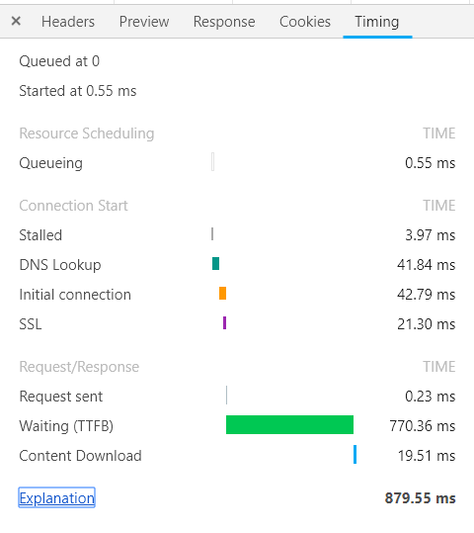
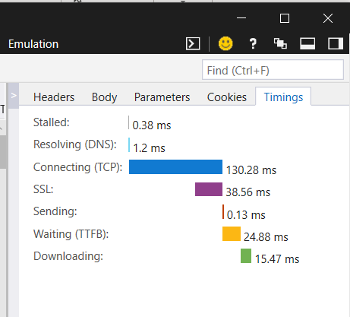
Browser: Developer Tools – Network tab (cont.)
Timing examples:

Slide 21
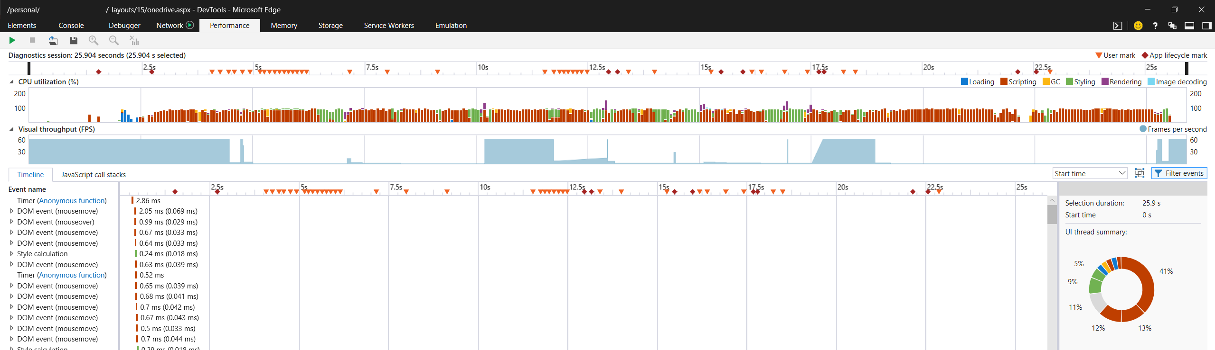
Browser: Developer Tools – Performance tab
Microsoft Internet Explorer / Microsoft Edge
Timeline
Legend
CPU utilization
Summary
Request waterfall

Slide 22
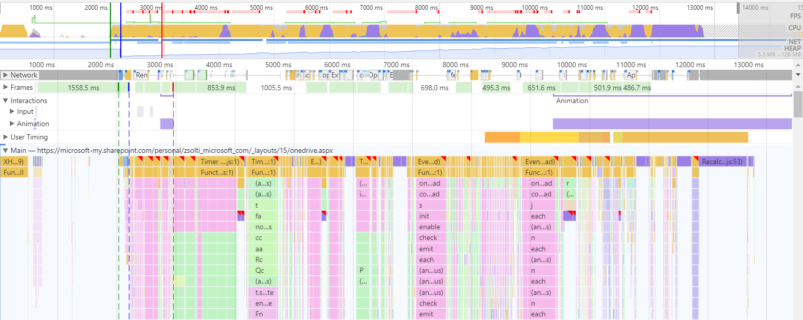
Browser: Developer Tools – Performance tab
Google Chrome
Timeline
CPU utilization
Summary

Slide 23
Microsoft Edge Developer Tools
In this demo we will show the Developer Tools work in Microsoft Edge.

Slide 24
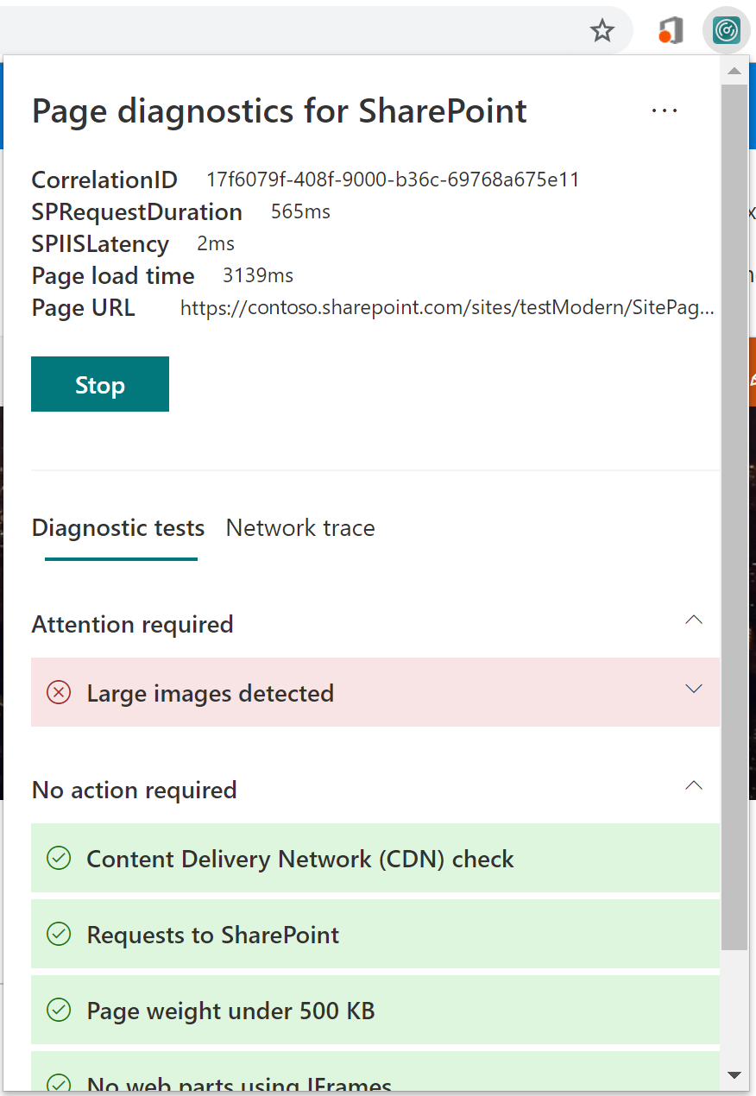
Browser: SharePoint Page Diagnostics tool
Official Microsoft tool:
Diagnose and troubleshoot page performance issues.
Version 2.0.0+ supports modern and classic pages.
gives basic tests for known issues for:
Developers of customization: to check best practices
Power Users: to report issues
Admins: to narrow down issues
Available for Chrome/Microsoft Edge (Chromium based)
Notes:
V2 supports modern now
Microsoft Edge Chromium version is supported

Slide 25
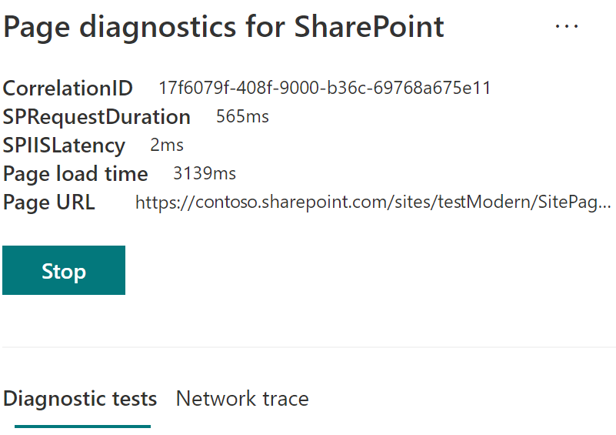
Browser: SharePoint Page Diagnostics tool (cont.)
Retrieves CorrelationID, url, etc…
The tool is publicly documented here.
Notes:
The tool is publicly documented at : https://docs.microsoft.com/en-us/office365/enterprise/page-diagnostics-for-spo

Slide 26
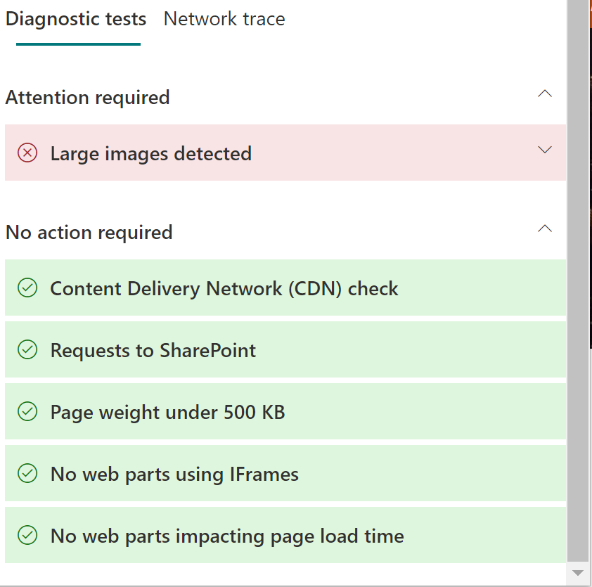
Browser: SharePoint Page Diagnostics tool (cont.)
Diagnoses most common issues:
Notes:
The tool is publicly documented at : https://docs.microsoft.com/en-us/office365/enterprise/page-diagnostics-for-spo
Large image recommendation: should be under 300KB

Slide 27
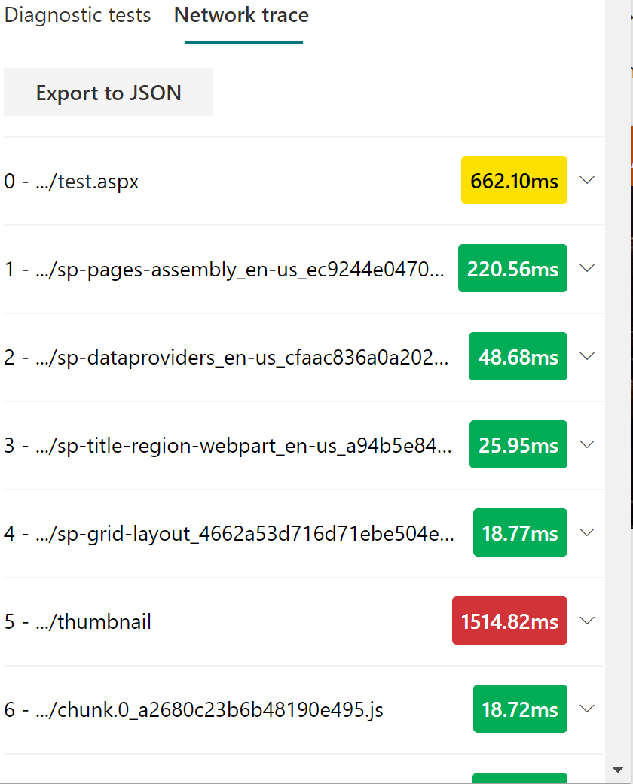
Browser: SharePoint Page Diagnostics tool (cont.)
Capture network timing
Surfaces large files
Notes:
The tool is publicly documented at :https://docs.microsoft.com/en-us/office365/enterprise/page-diagnostics-for-spo

Slide 28
SharePoint Diagnostics Tool
In this demo we will show the SharePoint Diagnostics Tool.

Slide 29
Support tools - JSON visualizer
SPO talks JSON:
Web service calls
List data
Example JSON:
{"lastUpdate":1527694471444,"cultureName":"en-US","timestamp":1550514586748,"apps":[{"CollectorId":"FirstParty","Id":"OfficeForms","Title":"Forms","BrandBarText":null,"AriaLabel":null,"Publisher":"Microsoft","FontIconCss":"ms-Icon ms-Icon--OfficeFormsLogo","TargetWindow":null,"BackgroundColor":"#008272","LaunchFullUrl":"https://forms.office.com/Pages/DesignPage.aspx?auth_pvr=OrgId&auth_upn=user@contoso.onmicrosoft.com&origin=shell","IsAutoPinnedDisabled":true,"CustomActions":[{"ActionVerb":1},{"ActionVerb":2}],"Size":2,"IsNewGroup":false},{"CollectorId":"FirstParty","Id":"OfficeStore","Title":"Add-In","BrandBarText":null,"AriaLabel":null,"Publisher":"Microsoft","FontIconCss":"ms-Icon ms-Icon--AddIn","TargetWindow":null,"BackgroundColor":"#d83b01","LaunchFullUrl":"https://store.office.com/redirect.aspx","IsAutoPinnedDisabled":true,"CustomActions":[{"ActionVerb":1},{"ActionVerb":2}],"Size":2,"IsNewGroup":false}]}

Slide 30
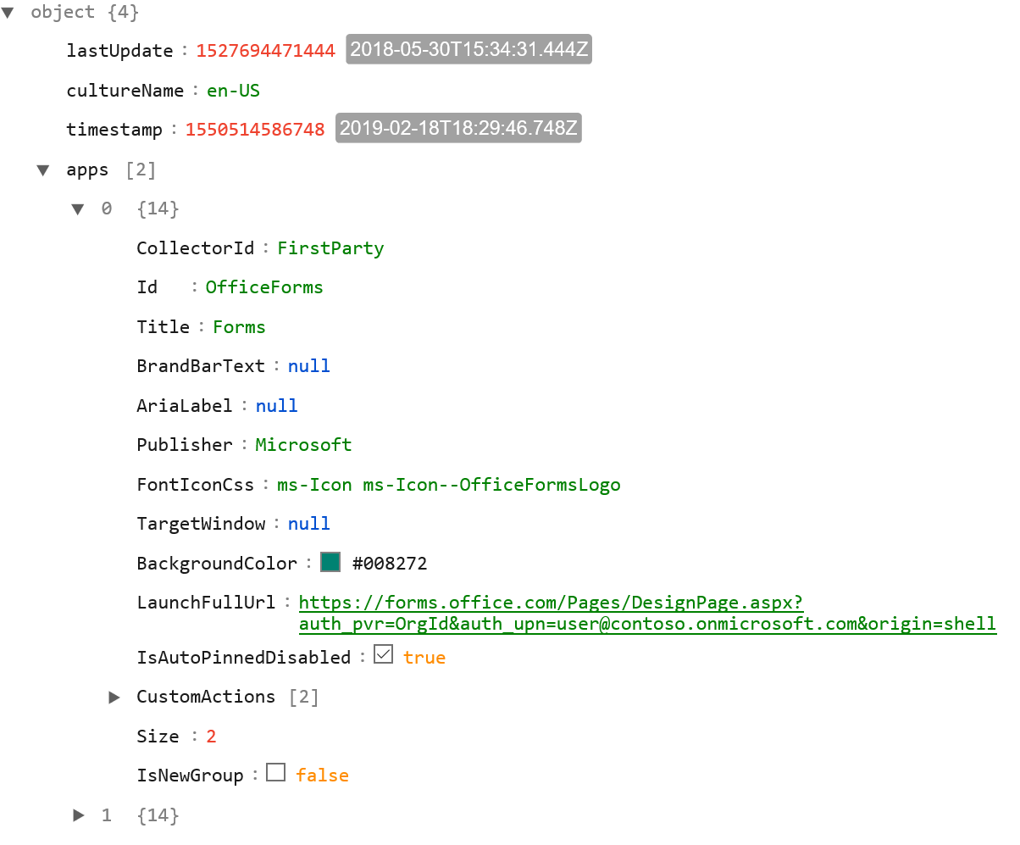
Support tools - JSON visualizer (cont.)
JSON Visualizers
https://jsoneditoronline.org/
https://jsonformatter-online.com/
Etc.
These are public services!
Use them with caution.

Slide 31
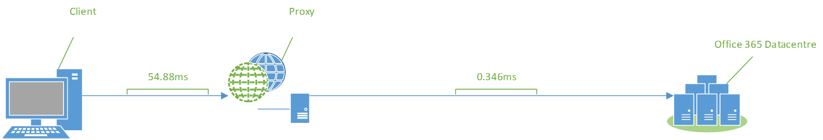
What is affecting the network performance? (cont.)
Latency/Round Trip Time (RTT):
The delay between different nodes on the network.
Use MicrosoftSysinternals tool: PSPing.
When proxy is in use that’s the boundary of the internal network.
PSP’ing might not work outside of the network. Use Netmon/Wireshark

Slide 32
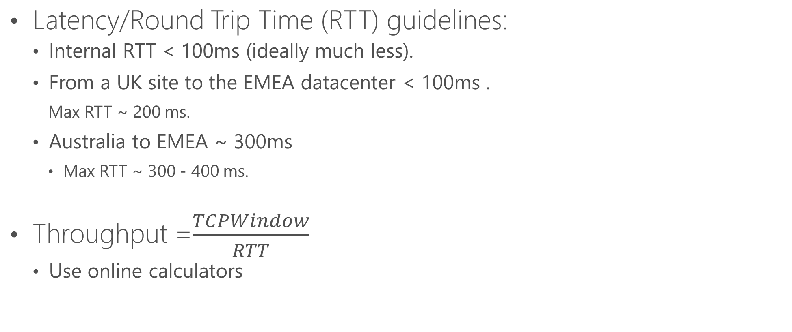
What is affecting the network performance? (cont.)
Latency/Round Trip Time (RTT) guidelines:
Internal RTT < 100ms (ideally much less).
From a UK site to the EMEA datacenter < 100ms .
Max RTT ~ 200 ms.
Australia to EMEA ~ 300ms
Max RTT ~ 300 - 400 ms.
Throughput =$\frac{TCPWindow}{RTT}$
Use online calculators
Round trip time (ms) | Maximum throughput (mbps) without scaling | Maximum throughput (mbps) with scaling
300 | 1.71 | 447.36
200 | 2.56 | 655.32
100 | 5.12 | 1310.64
50 | 10.24 | 2684.16
25 | 20.48 | 5368.32
10 | 51.20 | 13420.80
5 | 102.40 | 26841.60
1 | 512.00 | 134208.00

Slide 33
What is affecting the network performance?
TCP Window Scaling:
A receive buffer, defines the amount of data that can be sent in one transaction.
If too small,it causes stop start data transfer.
Check with the Netsh int tcp show global command.
“Receive Window Auto-Tuning level” should be “normal”
TCP Idle time settings:
Idle TCP channels are force closed.
To detect broken channels.

Slide 34
What is affecting the network performance? (cont.)
Proxy Authentication and scaling:
Can take significant time.
Fiddler and network trace shows this.
Make sure the proxy is prepared for the load.
DNS performance:
Seems obvious, but often causing problems.
Network monitoring is needed.
Use “conversation.DNS.ID==124” filter in Netmon

Slide 35
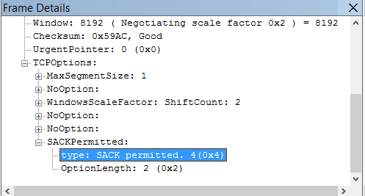
What is affecting the network performance? (cont.)
TCP Max Segment size:
The largest amount of data (bytes), that a device can receive in a single TCP segment.
If too low, too many packages need to be sent.
Selective Acknowledgement:
Should be enabled to deal with dropped packages more effectively.
Check a network trace.

Slide 36
Why use the Office 365 Network Onboarding tool?
Proof of Concept (PoC) tool.
Not only SPO
Guidance about networking connectivity improvements:
Geo distance to MS datacenters/O365 Front Door egress.
Speed comparison to other customers in the same area.
Network latency
DNS resolution times
Media traffic statistics

Slide 37
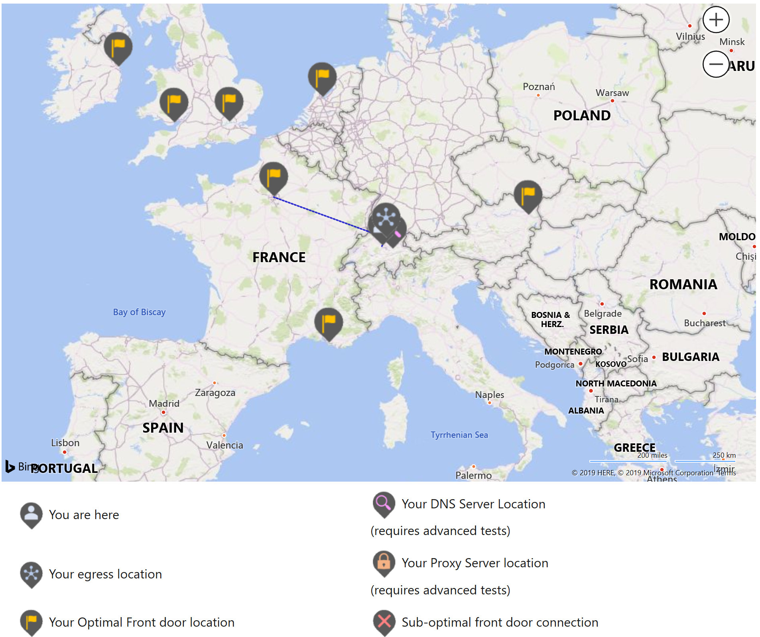
Results in the Office 365 Network Onboarding tool
Visual representation.

Slide 38
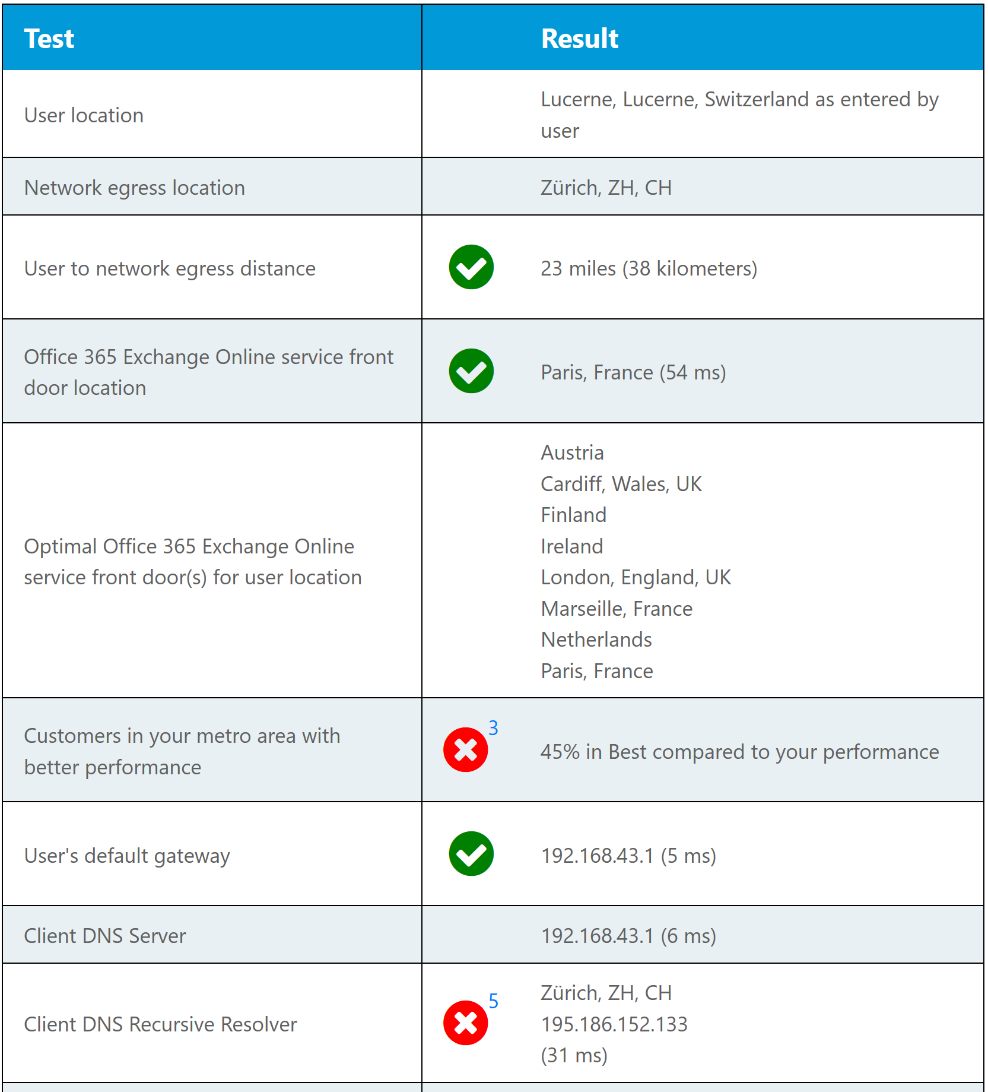
Results in the Office 365 Network Onboarding tool
Detailed test results
Showing errors and explanations.
Giving recommendations on how to resolve.

Slide 39
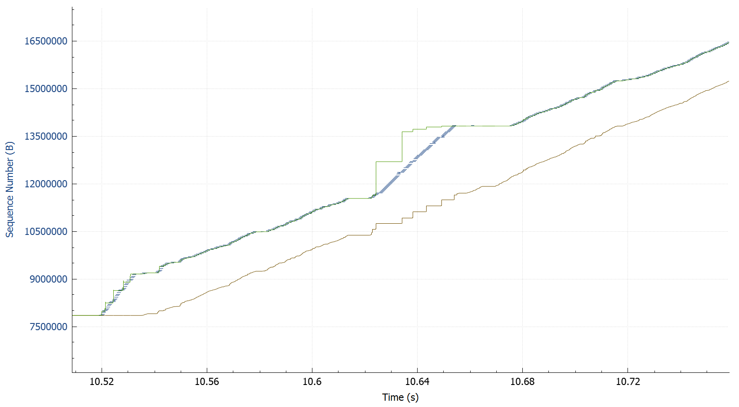
Why use WireShark?
WireShark is easy to collect data for Microsoft SharePoint Support.
Gives options for graphing data.
Richer experience with filtering.
We will need WireShark with Fiddler to identify requests.

Slide 40
Can you do basic network timing calculation from the information in Fiddler?
Yes.
What data structure SharePoint uses for the Modern UI?
JSON.
What’s the name of the tool that helps scanning for basic network issues?
O365 Network Onboarding Tool

Slide 41
The browsers’ Developer Tools are a good basic troubleshooting asset.
Fiddler is a good 3rd party tool to get deeper in troubleshooting.
Network settings (both on client-, and server-side can affect performance.
The O365 Network Onboarding Tool helps understanding and scan for the most common issues.

Slide 42

Questions?
Notes:
Do not answer these yet. Bring these up now so that the students can think about their answers after we run through the rest of the modules.

